Slide 1
A core Course on Modeling
Introduction to Modeling
0LAB0 0LBB0 0LCB0 0LDB0
c.w.a.m.v.overveld@tue.nl
v.a.j.borghuis@tue.nl
P.8

Slide 2
Contents:
Finding useful notions from mathematics
The relation wizard
Example: the marketshare function

Slide 3
Finding useful notions from mathematics
If you know the technical term, go to
http://en.wikipedia.org/wiki/Mathematics
http://nl.wikipedia.org/wiki/MathWorld
http://mathworld.wolfram.com/
If you don’t know the terminology, you may go to
http://www.keesvanoverveld.com/modeling/lectureMaterial/relwiz.html
or click here (‘relation wizard’):

Slide 4
The relation wizard
Start with some relation in mind
Questions ask about specific features to narrow down the mathematical domain
Clicking the selected answer leads to follow-up pages
If you get lost: use parent-links to get back on track
Notes:
4

Slide 5
Example: the market share function
Is the relation stochastic or deterministic?
We look for a glass box model → deterministic
Notes:
5

Slide 6
Example: the market share function
Is the relation a function?
We believe that market share depends on price per item → function
Notes:
6

Slide 7
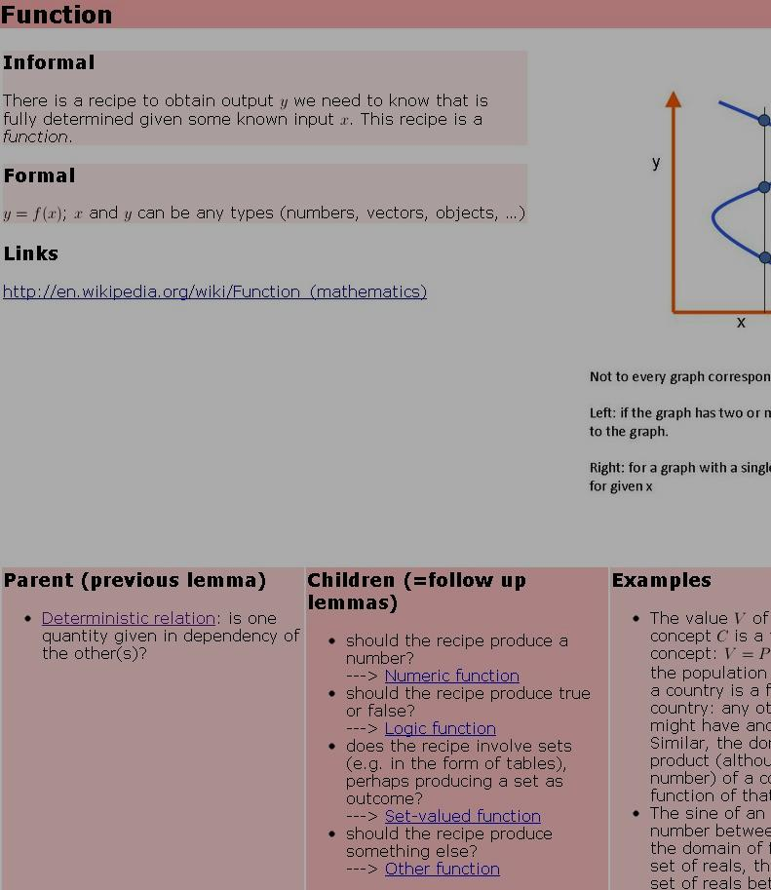
Example: the market share function
What type of quantities should result?
Market share is a number → numeric function
Notes:
7

Slide 8
Example: the market share function
Do we know something about the global features or the local features of the function?
No idea: just guess → local features
(if our guess is wrong, we can back up later)
Notes:
8

Slide 9
Example: the market share function
Is the function monotonic or not monotonic?
Market share decreases with increasing price per item → monotonic
Notes:
9

Slide 10
Example: the market share function
Is the function smooth or not smooth?
Simplest assumption: If the price per item changes little, the market share will also change little → smooth
Notes:
10

Slide 11
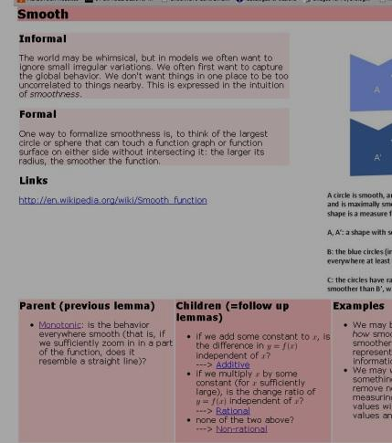
Example: the market share function
Is the function additive, rational or non-rational?
We may not know these terms, so we must carefully read the explanation. Then we find → non-rational
Notes:
11

Slide 12
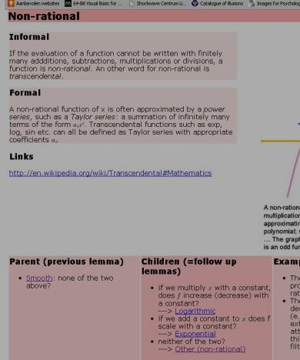
Example: the market share function
Is the function logarithmic, exponential or other?
We can verify that logarithmic and exponential functions don’t have the right behavior → other
Notes:
12

Slide 13
Example: the market share function
There are no further questions, so no further sub-categories in the relation wizard.
The ‘examples’-section of this lemma, however, describes the logistic function – which is exacly the function we need in the current case.
Notes:
13

